Slide 1
Chapter 19 Ajax
簡廷因 Ting-Ying Chien
2015.12.28

Slide 2
Outline
Introduction
“Raw” Ajax Example Using the XMLhttpRequest Object
jQuery Ajax

Slide 3
Introduction
Ajax applications separate client-side user interaction and server communication, and run them in parallel, making the delays of server-side processing more transparent to the user
“Raw” Ajax uses JavaScript to send asynchronous requests to the server, then updates the page using the DOM
When writing “raw” Ajax you need to deal directly with cross-browser portability issues, making it impractical for developing large-scale applications

Slide 4
Introduction
Client-side of Ajax applications
Written in HTML5 and CSS3
Uses JavaScript to add functionality to the user interface
XML and JSON are used to structure the data passed between the server and the client
XMLHttpRequest
The Ajax component that manages interaction with the server

Slide 5
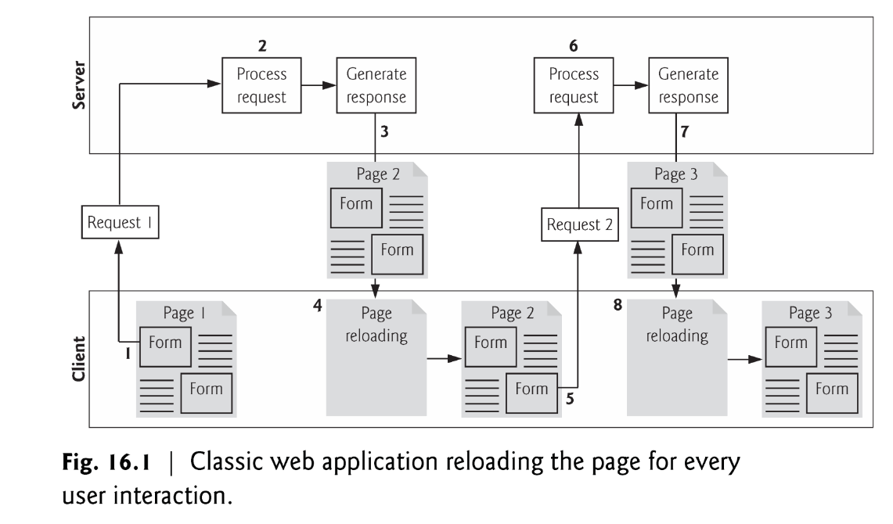
Introduction
Traditional web applications
While a synchronous request is being processed on the server, the user cannot interact with the client web browser
Client waits for the server to respond and reloads the entire page with the data from the response

Slide 6
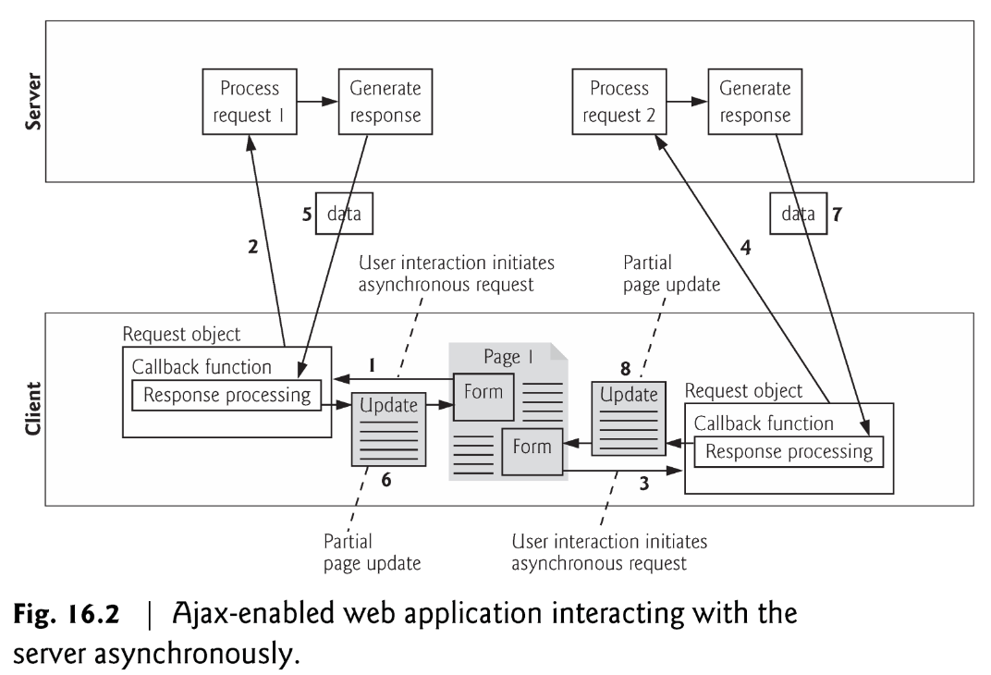
Introduction
Ajax Web Applications
Callback function updates only a designated part of the page
Partial page updates help make web applications more responsive, making them feel more like desktop applications

Slide 7
“Raw” Ajax Example Using the XMLhttpRequest Object
<!DOCTYPE html>
<html>
<head>
<meta charset = "utf-8">
<style type = "text/css">
.box { border: 1px solid black; padding: 10px }
</style>
<title>Switch Content Asynchronously</title>
<script>
var asyncRequest; // variable to hold XMLHttpRequest object
function registerListeners()
{
var img;
img = document.getElementById( "cpphtp" );
img.addEventListener( "mouseover", function() { getContent( "cpphtp.html" ); }, false );
img.addEventListener( "mouseout", clearContent, false );
img = document.getElementById( "iw3htp" );
img.addEventListener( "mouseover", function() { getContent( "iw3htp.html" ); }, false );
img.addEventListener( "mouseout", clearContent, false );
img = document.getElementById( "jhtp" );
img.addEventListener( "mouseover", function() { getContent( "jhtp.html" ); }, false );
img.addEventListener( "mouseout", clearContent, false );
img = document.getElementById( "vbhtp" );
img.addEventListener( "mouseover", function() { getContent( "vbhtp.html" ); }, false );
img.addEventListener( "mouseout", clearContent, false );
img = document.getElementById( "vcshtp" );
img.addEventListener( "mouseover", function() { getContent( "vcshtp.html" ); }, false );
img.addEventListener( "mouseout", clearContent, false );
img = document.getElementById( "javafp" );
img.addEventListener( "mouseover", function() { getContent( "javafp.html" ); }, false );
img.addEventListener( "mouseout", clearContent, false );
}
http://140.138.77.210/course/ch16.zip

Slide 8
“Raw” Ajax Example Using the XMLhttpRequest Object
function getContent( url )
{
try
{
asyncRequest = new XMLHttpRequest(); // create request object
// register event handler
asyncRequest.addEventListener("readystatechange", stateChange, false);
asyncRequest.open( "GET", url, true ); // prepare the request
asyncRequest.send( null ); // send the request
}
catch ( exception )
{
alert( "Request failed." );
}
}
function stateChange()
{
if ( asyncRequest.readyState == 4 && asyncRequest.status == 200 )
{
document.getElementById( "contentArea" ).innerHTML =
asyncRequest.responseText;
}
}
function clearContent()
{
document.getElementById( "contentArea" ).innerHTML = "";
}
window.addEventListener( "load", registerListeners, false );
</script>
</head>

Slide 9
“Raw” Ajax Example Using the XMLhttpRequest Object
<body>
<h1>Mouse over a book for more information.</h1>
<img id = "cpphtp" alt = "C++ How to Program book cover"
src = "http://test.deitel.com/images/thumbs/cpphtp8.jpg">
<img id = "iw3htp" alt = "Internet & WWW How to Program book cover"
src = "http://test.deitel.com/images/thumbs/iw3htp5.jpg">
<img id = "jhtp" alt = "Java How to Program book cover"
src = "http://test.deitel.com/images/thumbs/jhtp9.jpg">
<img id = "vbhtp" alt = "Visual Basic 2010 How to Program book cover"
src = "http://test.deitel.com/images/thumbs/vb2010htp.jpg">
<img id = "vcshtp" alt = "Visual C# 2010 How to Program book cover"
src = "http://test.deitel.com/images/thumbs/vcsharp2010htp.jpg">
<img id = "javafp" alt = "Java for Programmers book cover"
src = "http://test.deitel.com/images/thumbs/javafp.jpg">
<div class = "box" id = "contentArea"></div>
</body>
</html>

Slide 10
“Raw” Ajax Example Using the XMLhttpRequest Object
XMLHttpRequest object
Resides on the client
Is the layer between the client and the server that manages asynchronous requests in Ajax applications
Supported on most browsers, though they may implement it differently
To initiate an asynchronous request
Create an instance of the XMLHttpRequest object
Use its open method to set up the request, and its send method to initiate the request
When an Ajax application requests a file from a server, the browser typically caches that file
Subsequent requests for the same file can load it from the browser’s cache
When the third argument to XMLHttpRequest method open is true, the request is asynchronous

Slide 11
“Raw” Ajax Example Using the XMLhttpRequest Object
XMLHttpRequest object
open function
Specifies the type of request
Parameter
method: the type of request: GET or POST
url: the server (file) location
async: true (asynchronous) or false (synchronous)
send function
Sends the request to the server
Example :
xhttp.open("GET", "demo_get2.php?fname=Henry&lname=Ford", true);
xhttp.send();
xhttp.open("POST", "ajax_test.php", true);
xhttp.send("fname=Henry&lname=Ford");
Ref: http://www.w3schools.com/ajax/ajax_xmlhttprequest_send.asp

Slide 12
“Raw” Ajax Example Using the XMLhttpRequest Object
XMLHttpRequest object
readyState
Holds the status of the XMLHttpRequest. Changes from 0 to 4
0: request not initialized
1: server connection established
2: request received
3: processing request
4: request finished and response is ready
Status
HTTP status code
200: "OK" 404: Page not found
Ref: http://www.w3schools.com/ajax/ajax_xmlhttprequest_onreadystatechange.asp

Slide 13
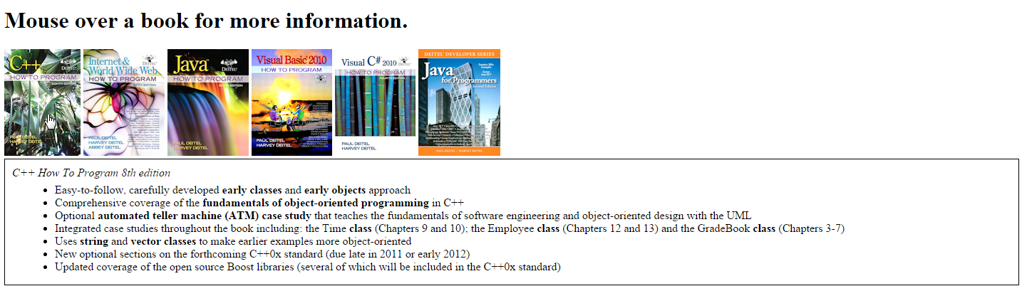
“Raw” Ajax Example Using the XMLhttpRequest Object

Slide 14
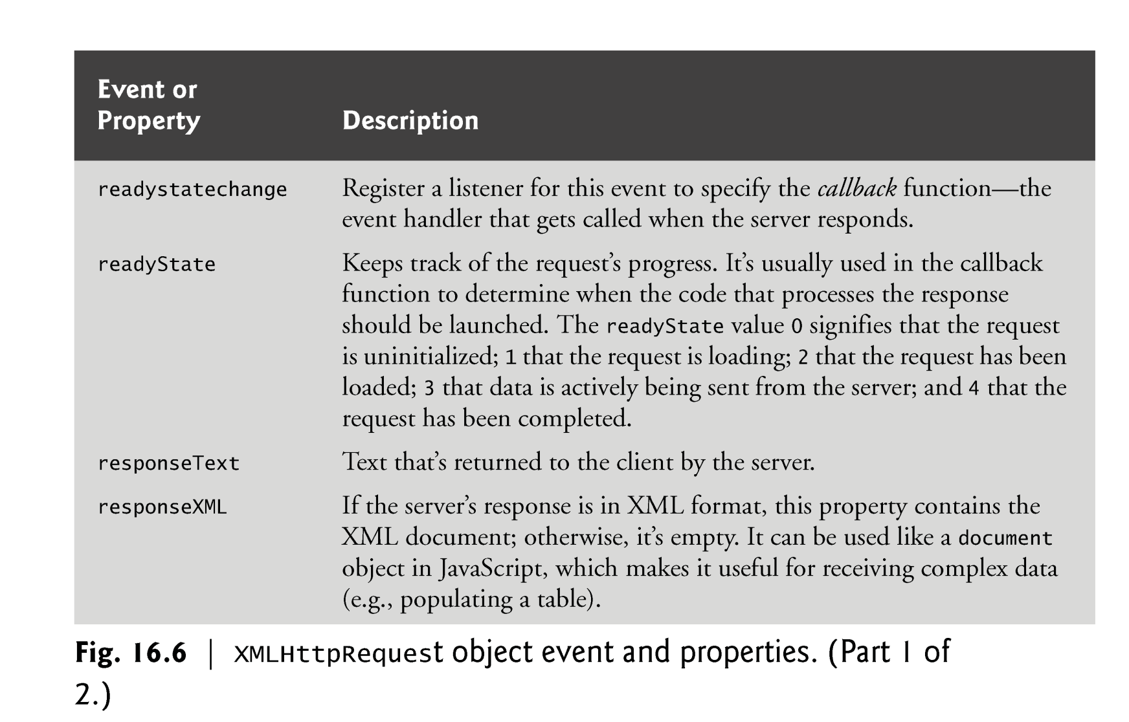
XMLHttpRequest object

Slide 15
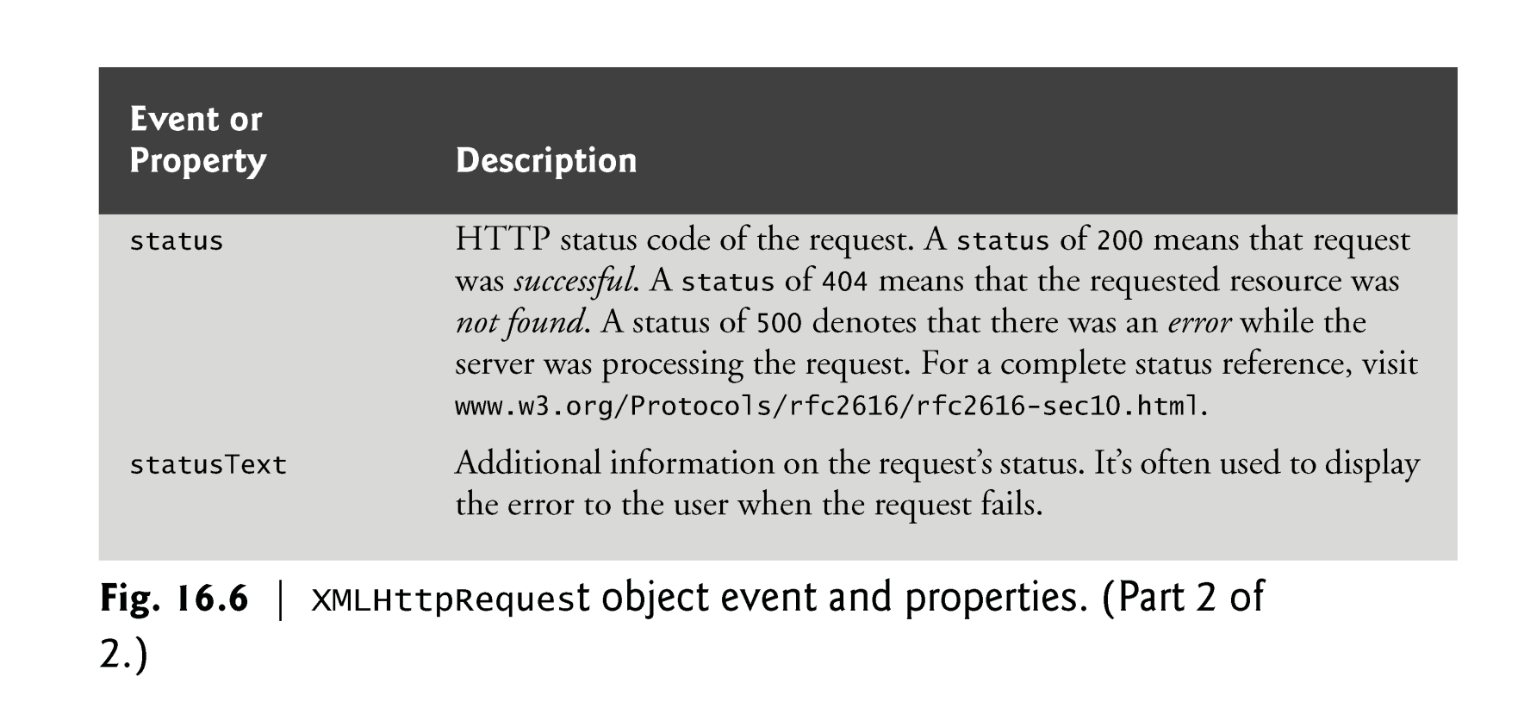
XMLHttpRequest object

Slide 16
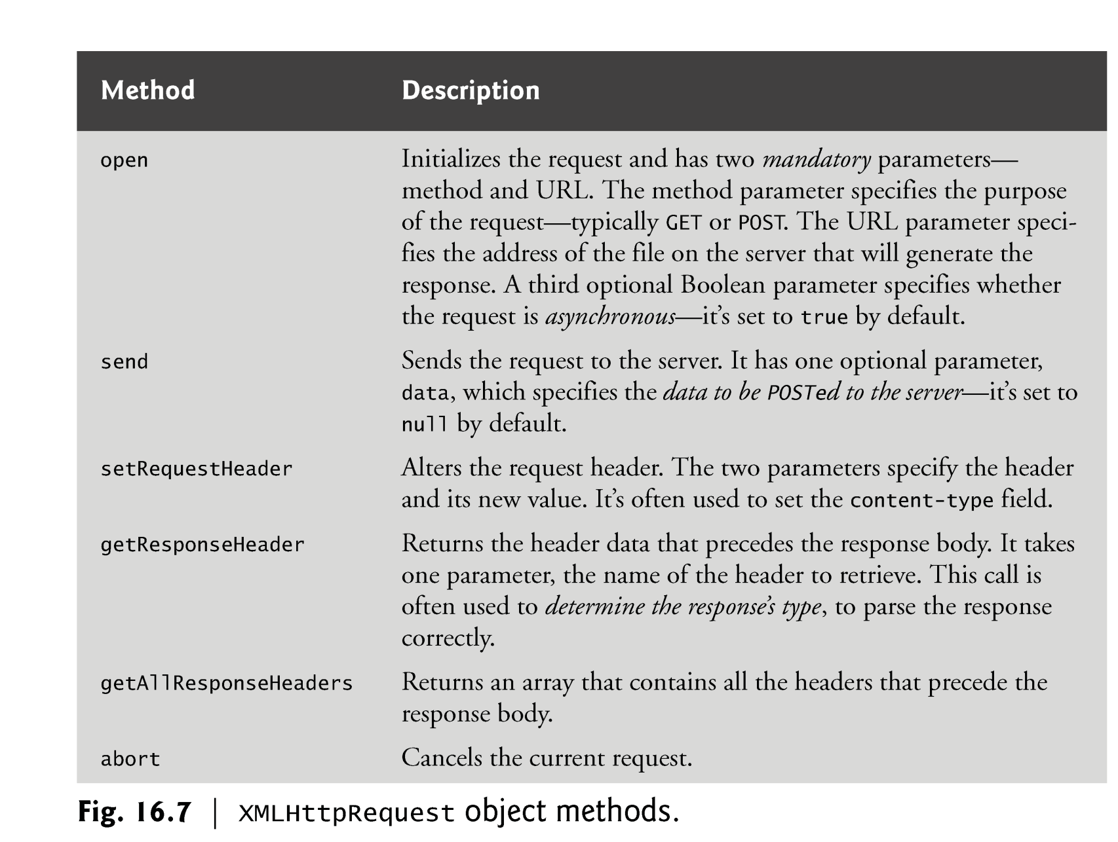
XMLHttpRequest object

Slide 17
jQuery Ajax

Slide 18
Introduction
jQuery is a fast, small, and feature-rich JavaScript library. It makes things like HTML document traversal and manipulation, event handling, animation, and Ajax much simpler with an easy-to-use API that works across a multitude of browsers.

Slide 19

jQuery Ajax + PHP
<!DOCTYPE html>
<html>
<head>
<meta charset = "utf-8">
<title>jQuery Ajax and PHP</title>
<script src="//code.jquery.com/jquery-2.1.4.min.js"></script>
<script>
function start()
{
var id = window.prompt( "Please enter your ID" );
$.ajax({
url: "test.php",
data: {
name: id
},
type: "POST",
datatype: "html",
success: function( output ) {
document.getElementById( "out" ).innerHTML = output;
},
error : function(){
alert( "Request failed." );
}
});
}
window.addEventListener( "load", start, false );
</script>
</head>
<body>
<div id="out"></div>
</body>
</html>
url:將資料傳到哪個位置
data:傳送的變數
type:傳送的方式 (GET/POST)
dataType:資料回傳的格式(html/script/json/xml)
success: 抓取資料成功後做的事
error: 抓取資料失敗後做的事
<?php
$name = $_POST["name"];
print ("<p>Hello, $name</p>");
?>
test.php

Slide 20
jQuery Ajax + PHP
<!DOCTYPE html>
<html>
<head>
<meta charset = "utf-8">
<title>jQuery Ajax and PHP</title>
<script src="//code.jquery.com/jquery-2.1.4.min.js"></script>
<script>
$(function(){
var id = window.prompt( "Please enter your ID" );
$.ajax({
url: "test.php",
data: {
name: id
},
type: "POST",
datatype: "html",
success: function( output ) {
$( "#out" ).html(output);
},
error : function(){
alert( "Request failed." );
}
});
});
</script>
</head>
<body>
<div id="out"></div>
</body>
</html>
<?php
$name = $_POST["name"];
print ("<p>Hello, $name</p>");
?>
test.php

Slide 21

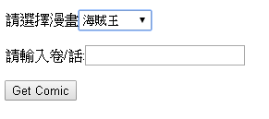
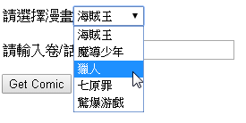
Exercise
Get comic automatically
jQuery Ajax + PHP
var cid = $("#cid").val();
var vol = $("#vol").val();
function urlexist ($url)
{
$headers = @get_headers($url);
if(strpos($headers[0],'404') === false)
{ return true;}
else { return false;}
}

Slide 22
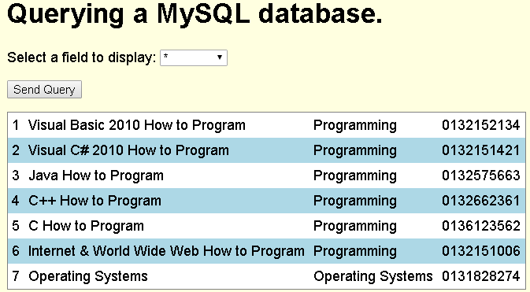
jQuery Ajax + PHP + MySQL
<!DOCTYPE html>
<html>
<head>
<meta charset = "utf-8">
<title>Sample Database Query</title>
<script src="//code.jquery.com/jquery-2.1.4.min.js"></script>
<script>
function progress() {
var sel = $("#select").val();
$.ajax({
url: "database.php",
data: {
select: sel
},
type: "POST",
datatype: "html",
success: function( output ) {
$( "#out" ).html(output);
},
error : function(){
alert( "Request failed." );
}
});
}
</script>
<style type = "text/css">
body { font-family: sans-serif;
background-color: lightyellow; }
table { background-color: lightblue;
border-collapse: collapse;
border: 1px solid gray; }
td { padding: 5px; }
tr:nth-child(odd) { background-color: white; }
</style>
</head>

Slide 23
jQuery Ajax + PHP + MySQL
<body>
<h1>Querying a MySQL database.</h1>
<form method = "post" action = "#">
<p>Select a field to display:
<select id = "select">
<option selected>*</option>
<option>ID</option>
<option>Title</option>
<option>Category</option>
<option>ISBN</option>
</select></p>
<p><input id = "submit" type="button" value = "Send Query" onclick="progress()"></p>
</form>
<div id="out"></div>
</body>
</html>

Slide 24
jQuery Ajax + PHP + MySQL
database.php
<?php
$select = $_POST["select"];
$query = "SELECT " . $select . " FROM books";
if ( !( $database = mysql_connect( "localhost", "USERID", "password" ) ) )
die( "Could not connect to database </body></html>" );
if ( !mysql_select_db( "products", $database ) )
die( "Could not open products database </body></html>" );
if ( !( $result = mysql_query( $query, $database ) ) )
{
print( "<p>Could not execute query!</p>" );
die( mysql_error() . "</body></html>" );
}
mysql_close( $database );
print ("<table>");
while ( $row = mysql_fetch_row( $result ) )
{
print( "<tr>" );
foreach ( $row as $value )
print( "<td>$value</td>" );
print( "</tr>" );
}
print ("</table>");
?>

Slide 25
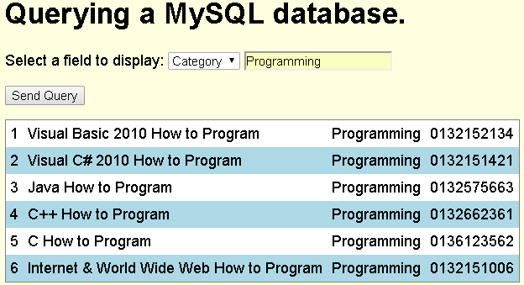
Exercise
Ref : ch19.v1.pptx p37

Slide 26
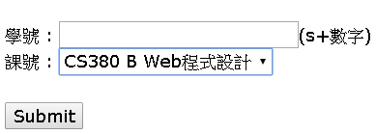
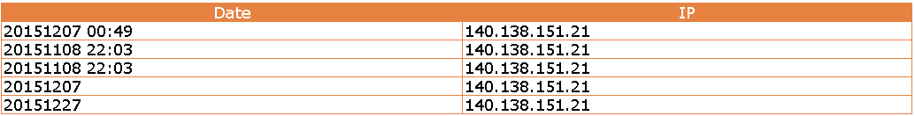
Exercise
簽到系統
Hint :
$today = date("Ymd");
$ip=$_SERVER['REMOTE_ADDR']

Slide 27
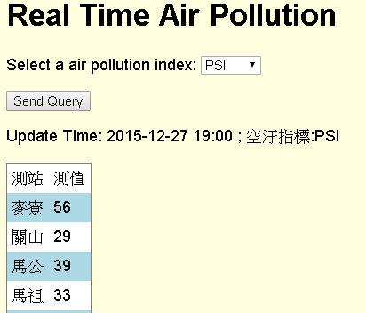
jQuery Ajax + PHP + CSV
<!DOCTYPE html>
<html>
<head>
<meta charset = "utf-8">
<title>Sample CSV Query</title>
<script src="//code.jquery.com/jquery-2.1.4.min.js"></script>
<script>
function progress() {
var aq = $("#aqindex").val();
$.ajax({
url: "csv.php",
data: {
aq: aq
},
type: "POST",
datatype: "html",
success: function( output ) {
$( "#out" ).html(output);
},
error : function(){
alert( "Request failed." );
}
});
}
</script>
<style type = "text/css">
body { font-family: sans-serif;
background-color: lightyellow; }
table { background-color: lightblue;
border-collapse: collapse;
border: 1px solid gray; }
td { padding: 5px; }
tr:nth-child(odd) { background-color: white; }
</style>
</head>

Slide 28
jQuery Ajax + PHP + CSV
<body>
<h1>Real Time Air Pollution</h1>
<form method = "post" action = "#">
<p>Select a air pollution index:
<select id = "aqindex">
<option selected>PSI</option>
<option>SO2</option>
<option>CO</option>
<option>O3</option>
<option>PM10</option>
<option>PM2.5</option>
<option>NO2</option>
</select></p>
<p><input id = "submit" type="button" value = "Send Query" onclick="progress()"></p>
</form>
<div id="out"></div>
</body>
</html>

Slide 29
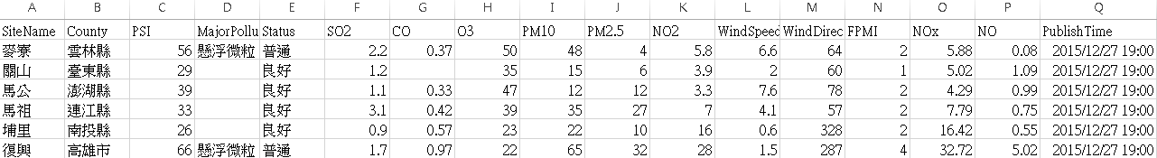
jQuery Ajax + PHP + CSV
<?php
$aq = $_POST["aq"];
$data = file_get_contents("http://opendata.epa.gov.tw/ws/Data/AQX/?format=csv");
$rows = explode("\n",$data);
$s = array();
$num=0;
foreach($rows as $row) {
$s[] = str_getcsv($row);
$num++;
}
$time = $s[1][16];
print ("<p>Update Time: $time ; 空汙指標:$aq</p>");
$index =0;
switch ($aq)
{
case "PSI":$index=2;break;
case "SO2":$index=5;break;
case "CO":$index=6;break;
case "O3":$index=7;break;
case "PM10":$index=8;break;
case "PM2.5":$index=9;break;
case "NO2":$index=10;break;
}
print ("<table><tr><td>測站</td><td>測值</td></tr>");
for ($i=1;$i<$num-1;$i++)
{
$station = $s[$i][0];
$value = $s[$i][$index];
print ("<tr><td>$station</td><td>$value</td></tr>");
}
print ("</table>");
?>

Slide 30
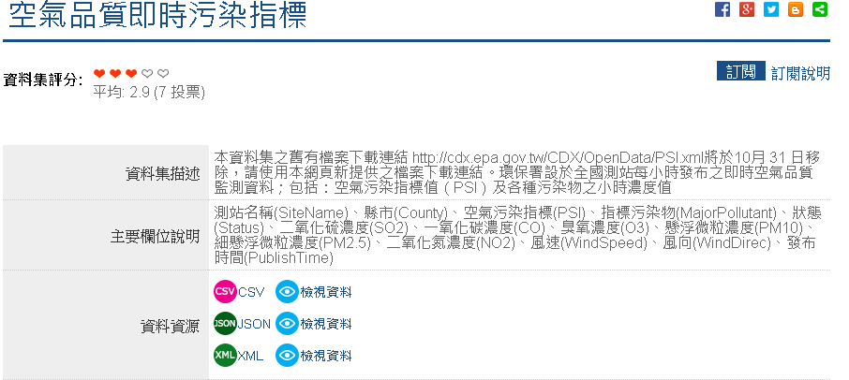
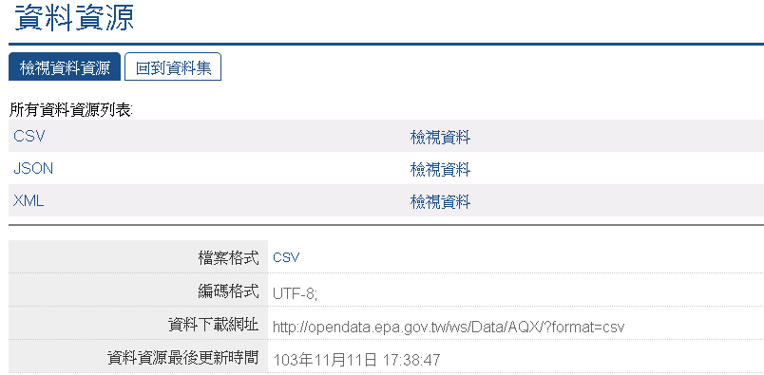
jQuery Ajax + PHP + CSV
Open Data
http://data.gov.tw/node/6074

Slide 31
Exercise
依使用者選擇, 列出該縣市測速執法設置點
Data:
http://data.gov.tw/node/7320

Slide 32
Q&A

